Slide 1

7.3 Network Security Controls
Network Security / G.Steffen

Slide 2
In This Section
Defense techniques to the network security engineer
Major controls:
  Firewalls
  Intrusion detection systems
  Encrypted e-mail
Network Security / G.Steffen

Slide 3
Security Threat Analysis
3 steps in analyzing a security threat:
  Scrutinize all the parts of the systems
  Consider the possible damage to confidentiality, integrity, & availability
  Hypothesize the kinds of attacks that could cause the specific kind of damage
Similar approach can be taken to analyze threats in a network.
Network Security / G.Steffen

Slide 4
What an Attacker Might Do?
Read communication
Modify communication
Forge communication
Inhibit communication
Inhibit all communication passing through a point
Read data at some machine C between two people
Modify or destroy data at C
Network Security / G.Steffen

Slide 5
Kinds of Threats
Intercepting data in traffic
Accessing programs or data at remote hosts
Modifying programs or data at remote hosts
Modifying data in transit
Inserting communications
Impersonating a user
Inserting a repeat of a previous communication
Blocking selected traffic
Blocking all traffic
Running a program at a remote host
Network Security / G.Steffen

Slide 6
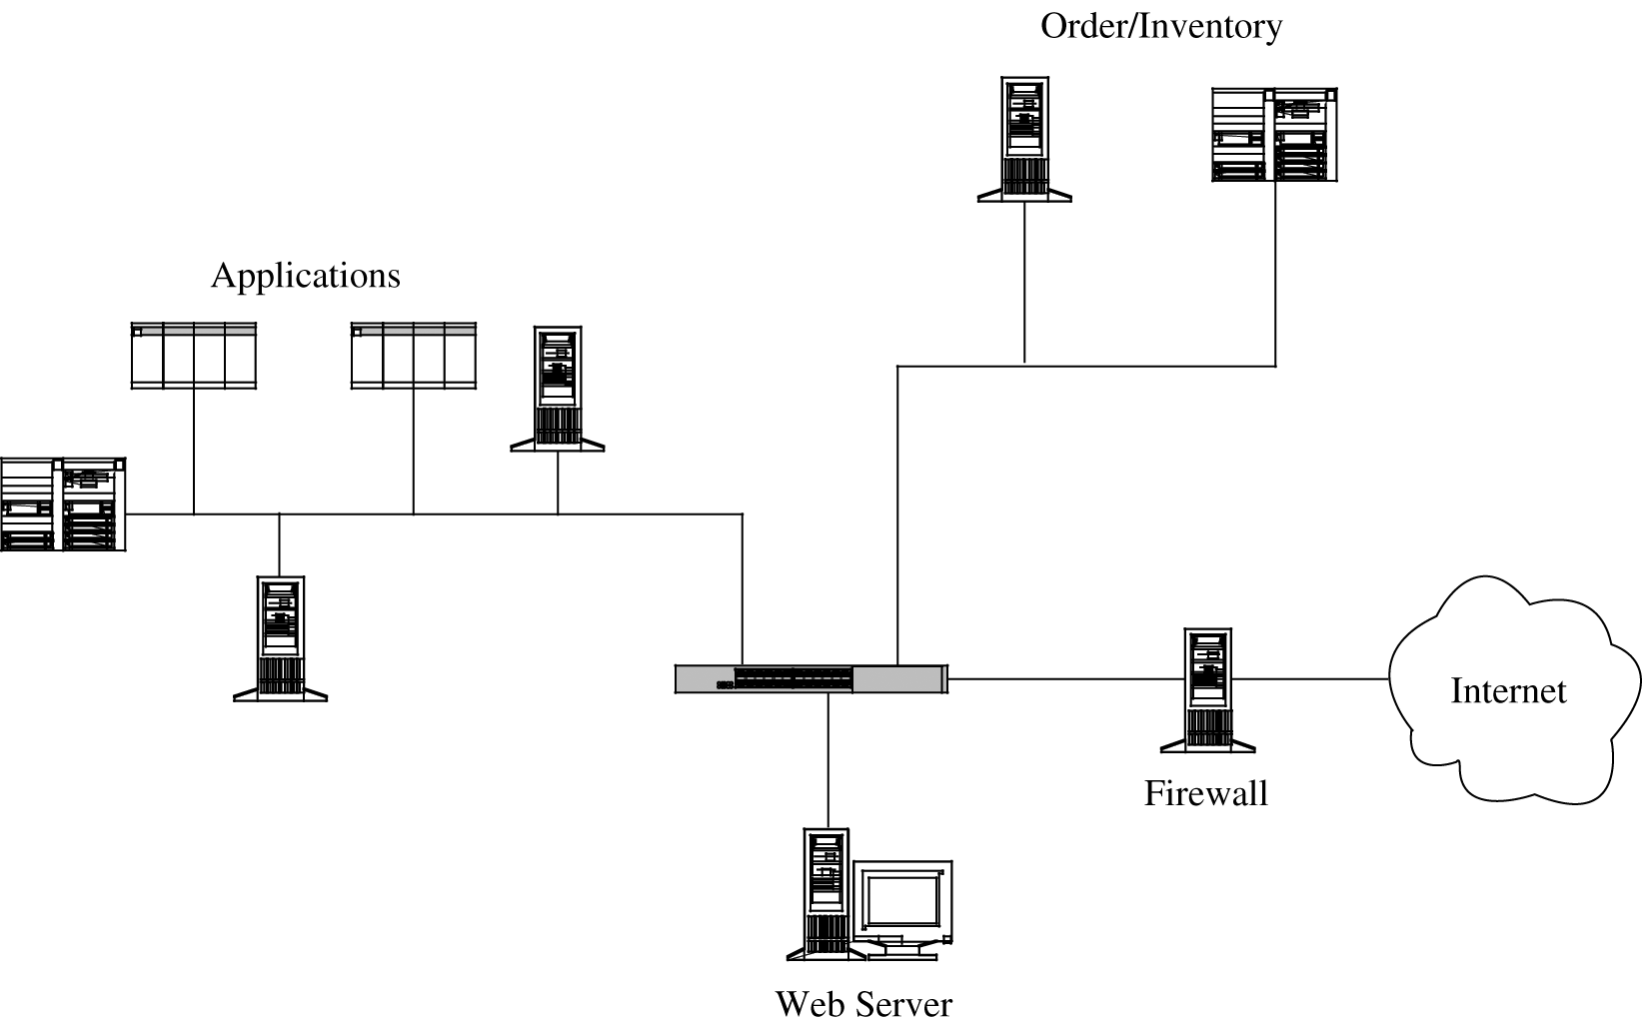
Architectural Security Control 1
Segmentation
  It reduces the number of
  threats
  It limits the amount of
  damage a single
  vulnerability
  can allow
Segmented Architecture
Network Security / G.Steffen

Slide 7
Architectural Security Control 2
Redundancy
  It allows a function to be performed on more than one node
  Failure over mode- The server communicates with each other periodically, each determining if the other is still active.
Single points of failure
  Eliminating a single point in the network which if failed, could deny access to all or a significant part of the network
Mobile agents
Network Security / G.Steffen

Slide 8
Encryption
Encryption is the most important & versatile tool for a network security expert.
Encryption is used for providing:
  Privacy
  Authenticity
  Integrity
  Limited access to data
Note: Encryption protects only what is encrypted
Network Security / G.Steffen

Slide 9
Kinds of Encryption 1
Link Encryption
  Data are encrypted just before the system places them on the physical communication link
  Encryption occurs at layer 1 or 2 in the OSI model
  Encryption protects the message in transit between two computers
  This kind of encryption is invisible to user
  It is most appropriate when the transmission line is the point of greatest vulnerability
Network Security / G.Steffen

Slide 10
Kinds of Encryption 2
End-to-End Encryption
  It provides security from one end of a transmission to the other
  The message is transmitted in encrypted form through the network
  It addresses potential flaws in lower layers in the transfer model
  When used, messages sent through several hosts are protected
Network Security / G.Steffen

Slide 11
Virtual Private Networks (VPN)
VPN allows users to access their internal networks and computers over the Internet or other public network, using encrypted tunnels (communication passes through encrypted tunnel).
VPN are created when the firewall interacts with an authentication service inside the parameter.
Firewall
  It is an access control device that sits between two networks or two network segments.
  It filters all traffic between the protected or “inside” network and a less trustworthy or “outside” network or segment.
Network Security / G.Steffen

Slide 12
Public Key Infrastructure (PKI)
PKI
  It is a set of policies, products, & procedures leaving some room for interpretation.
  It is a process created to enable users to implement public key cryptography, usually in large settings.
  It offers each user a set of services related to identification & access control.
  It sets up entitles called certificate authorities that implement the PKI policy on certificates.
  It is not yet a mature process.
Network Security / G.Steffen

Slide 13
Encryption
SSH (Secure Shell) encryption
  A pair of protocols, originally defined for UNIX
  It provides authenticated and encrypted path to the shell or operating system command interpreter.
SSL (Secure Sockets layer) encryption
  It is also known as TLS (Transport Layer Security)
  It was originally designed by Netscape
  It interfaces between applications and the TCP/IP protocols to provide server authentication, optional client authentication, & an encrypted communication channel between client & server.
Network Security / G.Steffen

Slide 14
IP Security Protocol Suite (IPSec)
IPSec
  It is designed to address fundamental shortcomings such as being subject to spoofing, eavesdropping, & session hijacking.
  It is implemented at the IP layer
  It is somewhat similar to SSL (supports authentication & confidentiality in a way that does not necessitate significant change either above or below it)
Security association
  The basis of IPSec
  It is roughly compared to an SSL session
Network Security / G.Steffen

Slide 15
Related Terms
Security Parameter Index (SPI)
  A data element that is essentially a pointer into a table of security associations.
Encapsulated Security Payload (ESP)
  It replaces (includes) the conventional TCP header and data portion of a packet.
  It contains both an authenticated header (AH) and an encrypted portion.
Internet Security Association Key Management Protocol (ISAKMP)
  It requires that a distinct key be generated for each security association.
  It is implemented through IKE or ISAKMP key exchange
Network Security / G.Steffen

Slide 16
Content Integrity
Three potential threats:
  Malicious modification that changes content in a meaningful way
  Malicious or non-malicious modification that changes content in a way that is not necessarily meaningful
  Non-malicious modification that changes content in a way that will not be detected
Network Security / G.Steffen

Slide 17
Guard Modification Threats
Error correcting codes
  Error detection & error correcting codes can be used to guard against modification in a transmission.
  Parity Check is the simplest error detection code technique.
    Even Parity – the parity bit is set so that the sum of all data bits plus the parity bit is even.
    Odd Parity – It is similar to the even parity bit except the sum is odd.
  Hash code or Huffman code are some other error detection codes
Network Security / G.Steffen

Slide 18
Cryptographic Checksum
Cryptographic Checksum (Message Digest)
  It is a cryptographic function that produces a checksum.
  It prevents the attacker from changing the data block.
  Major uses of cryptographic checksum are code tamper protection & message integrity protection in transit.
Network Security / G.Steffen

Slide 19
Authentication Methods
One-Time Password
  It is good for only one time use
  A password token can help in generating unpredictable passwords
  This technique is immune to spoofing as it works on a password generating algorithm
Challenge-Response System
  It looks like a simple pocket calculator
  This device eliminates the small window of vulnerability in which a user could reuse a time-sensitive authenticator
Digital Distributed Authentication
Network Security / G.Steffen

Slide 20
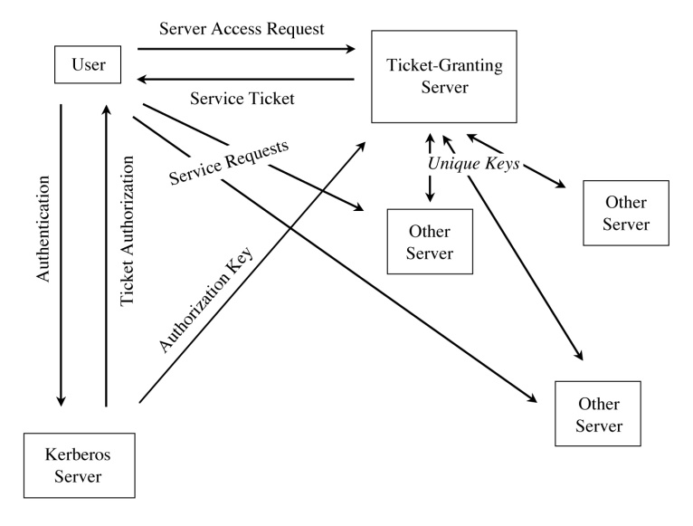
Access Controls
ACLs on Routers
  Problems on adding ACLs to the routers
    Routers in a large network perform a lot of work
    Efficiency issues
    Nature of threat
Firewalls
  Can examine an entire
  packet’s content, including
  the data portion.
Access to Services & Servers in Kerberos
Network Security / G.Steffen

Slide 21
Wireless Security 1
Service Set Identifier (SSID)
  It is the identification of an access point
  It is a string of up to 32 characters
Wired Equivalent Privacy (WEP)
  It uses an encryption key shared between the client and the access point.
  It uses either a 64bit or 128 bit encryption key.
WiFI protected access (WPA)
  It is an alternate to WEP
  The encryption key is changed automatically on each pocket by a key change approach called Temporal Key Integrity Program (TKIP)
Network Security / G.Steffen

Slide 22
Wireless Security 2
Alarms & Alerts
  An intrusion detection system is a device that is placed inside a protected network to monitor what occurs within the network.
Honey pots
  Loaded with servers, devices & data; it is a computer system or a network segment.
  A honeypot is put up for several reasons
    To watch what attackers do
    To lure an attacker to a place where you can identify and stop the attacker
    To provide an attractive but diversionary playground
Network Security / G.Steffen

Slide 23
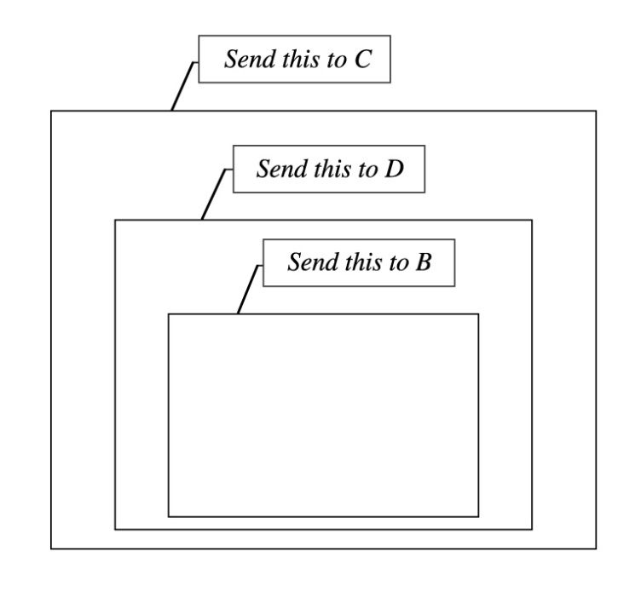
Wireless Security 3
Traffic Flow Security
  Onion routing – messages are repeatedly encrypted and then sent through several network
Onion Routing
Network Security / G.Steffen

Slide 24
Summary 1
Target | Vulnerability | Control
Authentication Failures | Impersonation Eavesdropping Spoofing Man-in-the Middle Attack | Strong, One-Time Authentication Encrypted Authentication Channel Strong, One-Time Authentication Strong, One-Time Authentication VPN Protocol Analysis
Network Security / G. Steffen

Slide 25
Summary 2
Target | Vulnerability | Control
Programming Flaws | Buffer Overflow Parameter Modifications | Programming Controls Personal Firewall Intrusion Detection System Personal Firewall
Confidentiality | Protocol Flaw Eavesdropping, Passive Wiretap, Mis-delivery Cookie | Programming Controls Controlled Execution Environment Encryption Firewall Intrusion Detection System
Network Security / G. Steffen

Slide 26
Summary 3
Target | Vulnerability | Control
Integrity | Protocol Flaw Active Wiretap Noise DNS Attack | Controlled Execution Environment Audit Encryption Error Detection Code Error Detection Code Firewall Intrusion Detection System Strong Authentication for DNS Changes Audit
Network Security / G. Steffen

Slide 27
Summary 4
Target | Vulnerability | Control
Availability | Protocol Flaw DNS Attack Traffic Redirection DDoS | Firewall Redundant Architecture Firewall Intrusion Detection System ACL on Border Router Honeypot Encryption Audit ACL on Border Router Honeypot
Network Security / G. Steffen

